Slide 1

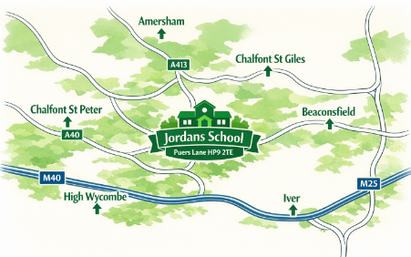

JORDANS SCHOOL
Open Days
Morning:
Friday 16th October
9:30am
Refreshments
Headteacher Talk
Tour of the School
Afternoon:
Thursday 19th November
1:30pm
Refreshments
Headteacher Talk
Tour of the School
www.jordans.bucks.sch.uk/

