Slide 1

Welcome to Year 2

Slide 2

Drop off and Pick up
Deer Class timetable
Reading
Homework/Spelling
Maths
PE
Library/Contact us

Slide 3

Drop off and Pick up
School gate open from 0845 and will shut at 0900
Pick up from classroom door at 3pm

Slide 4
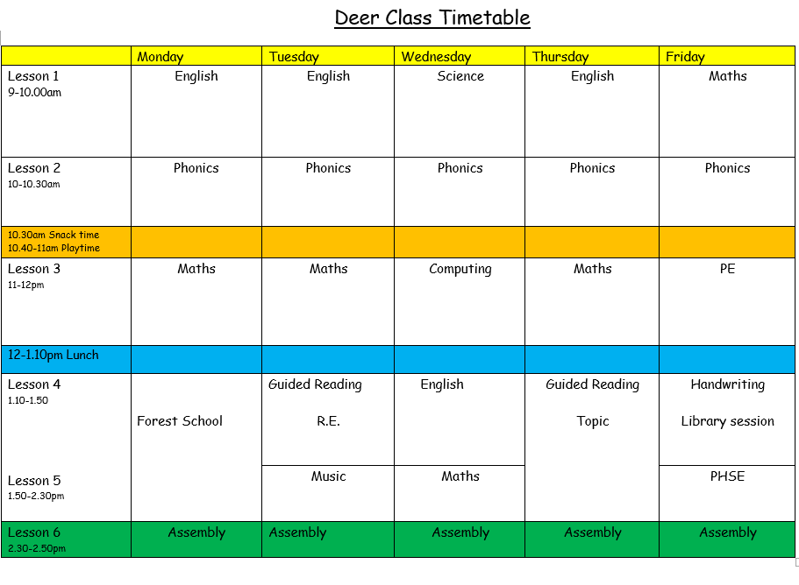

Slide 5
Reading
Read if possible with your child each evening for 15 minutes.
Ask lots of questions to check understanding.
The children will change their own books in the morning.
Reading records – do let us know how they are getting on or send us an email.

Slide 6
Homework/ Spelling
Spelling words will come home each Monday, we will review
them in school the following Monday
In addition the children need to be able to spell the Year 1 and
Year 2 common exception words, we will send a copy home.
Very occasionally we may send home homework
via Google classroom to support learning in school

Slide 7
Maths
Will be taught in the same way as Year 1
At the beginning of topics you will be sent a maths
newsletter/maths topic sheet ( these will be on the website too)
Any addition practise of number bonds, doubling, halving
and counting in 2s, 5s and 10s from any number
First topic will be on place value

Slide 8
PE/Uniform
On a Monday and Friday
Friday taught by specialist PE teachers
Please do name all uniform including water bottles

Slide 9
Library/Contact us
Friday will be our ‘library day’, so please remember books your child
may want to change
Always happy to speak to you and talk through any concerns or
queries no matter how big or small
deers@jordans.bucks.sch.uk

