Slide 1

Welcome to Year 2

Slide 2

Drop off and Pick up
Deer Class timetable
Reading
Homework/Spelling
Maths
PE
Library/Contact us

Slide 3
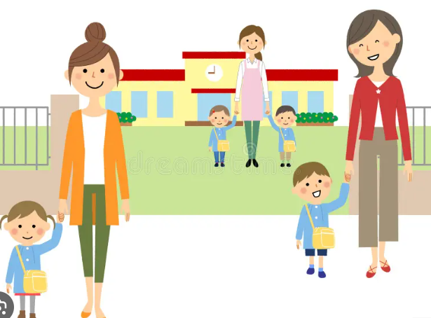

Drop off and Pick up
The school gate is open from 8.45
and will shut at 9.00
Pick up is from the classroom door at 3pm

Slide 4
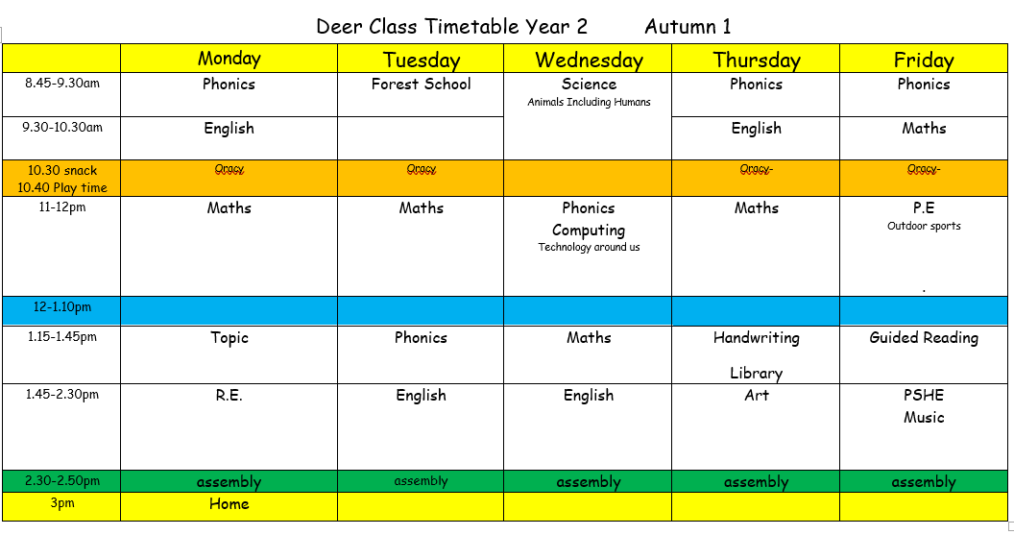

Slide 5

Reading
Read if possible with your child each evening for 15 minutes.
Ask lots of questions to check understanding.
The children will change their own books in the morning.
Reading records – do let us know how they are getting on or send us an email.

Slide 6
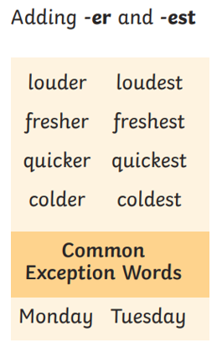
Homework/ Spelling
Spelling words will come home each Monday.
We will review them in school the following Monday.
There will be activities posted on Google classroom
each Friday to support our learning in school.

Slide 7
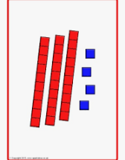
Maths
Will be taught in the same way as Year 1
At the beginning of topics you will be sent a maths
newsletter on Google Classroom
(these will be on the website too)
Any additional practise of number bonds, doubling, halving
and counting in 2s, 5s and 10s from any number
would be great!
Our first topic is ‘place value’

Slide 8


PE/Uniform
On a Tuesday and Friday
(this term we have forest school
as our Tuesday physical activity session)
Friday lessons are taught by specialist PE teachers
Please name all uniform including water bottles.
P.E. bags should stay in school for half a term. We will send them home for washing in the holidays.

Slide 9
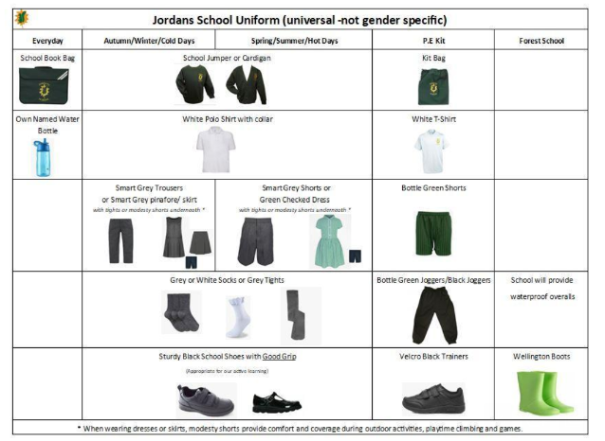

Slide 10
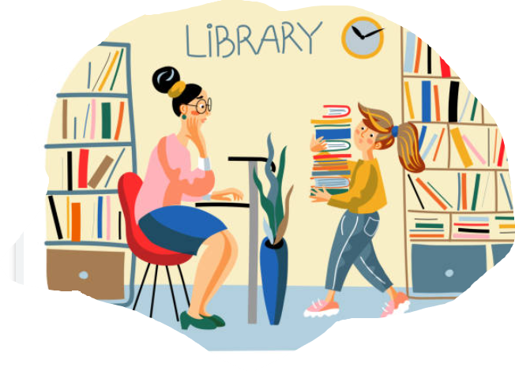
Library/Contact us
Thursday will be our library day,
so please remember books
your child may want to change.
I am always happy to speak to
you and talk through any concerns or
queries no matter how big or small.
deers@jordans.bucks.sch.uk

